Slide 1
Outlier
Introduction to Power Converters
Sinusoidal PWM (SPWM) Fundamentals
Space Vector Modulation (SVM) Theory
Discontinuous PWM (DPWM) Techniques
DPWM Classification & Implementation
GDPWM
Comparative Analysis & Applications
Conclusions

Slide 2
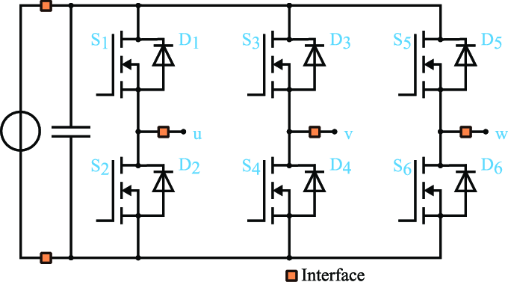
Two-Level Inverter
Topology

Slide 3
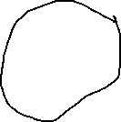
Freewheeling Diodes
Primary Functions:
  Provide safe current path for inductive loads
  Prevent voltage spikes during switching
  Protect semiconductor devices
  Enable continuous current flow in motor windings
Location: Anti-parallel to each switching device

Slide 4
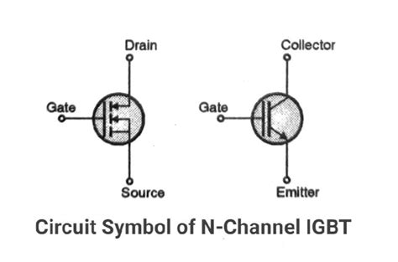
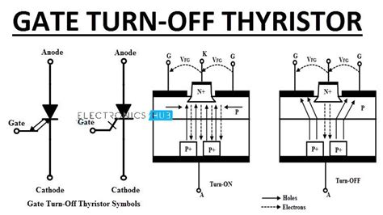
VSC
Voltage Source Converter
Key Features of VSCs
Self-Commutated: VSCs use self-commutated devices such as Insulated Gate Bipolar Transistors (IGBTs) or Gate Turn-Off Thyristors (GTOs), which can be turned on and off by a control signal. This allows for flexible control over the output waveform.
Notes:
In the context of power electronics and electrical engineering, VSC stands for Voltage Source Converter. A Voltage Source Converter is a type of power electronic converter that converts DC voltage to AC voltage or vice versa. It is called a "voltage source" because it is typically connected to a DC voltage source and can supply or absorb power from an AC system.

Slide 5
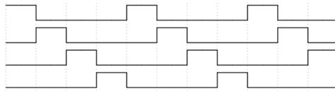
VSC
Voltage Source Converter
Key Features of VSCs
2. Pulse Width Modulation (PWM): VSCs often employ PWM techniques to generate the desired AC waveform from the DC input. PWM involves varying the width of the pulses to approximate a sinusoidal waveform.
Notes:
In the context of power electronics and electrical engineering, VSC stands for Voltage Source Converter. A Voltage Source Converter is a type of power electronic converter that converts DC voltage to AC voltage or vice versa. It is called a "voltage source" because it is typically connected to a DC voltage source and can supply or absorb power from an AC system.

Slide 6
VSC
Voltage Source Converter
Key Features of VSCs
3. Four-Quadrant Operation: VSCs can operate in all four quadrants of the power plane, meaning they can supply or absorb both real and reactive power. This capability is essential for applications requiring bidirectional power flow.
Notes:
In the context of power electronics and electrical engineering, VSC stands for Voltage Source Converter. A Voltage Source Converter is a type of power electronic converter that converts DC voltage to AC voltage or vice versa. It is called a "voltage source" because it is typically connected to a DC voltage source and can supply or absorb power from an AC system.

Slide 7
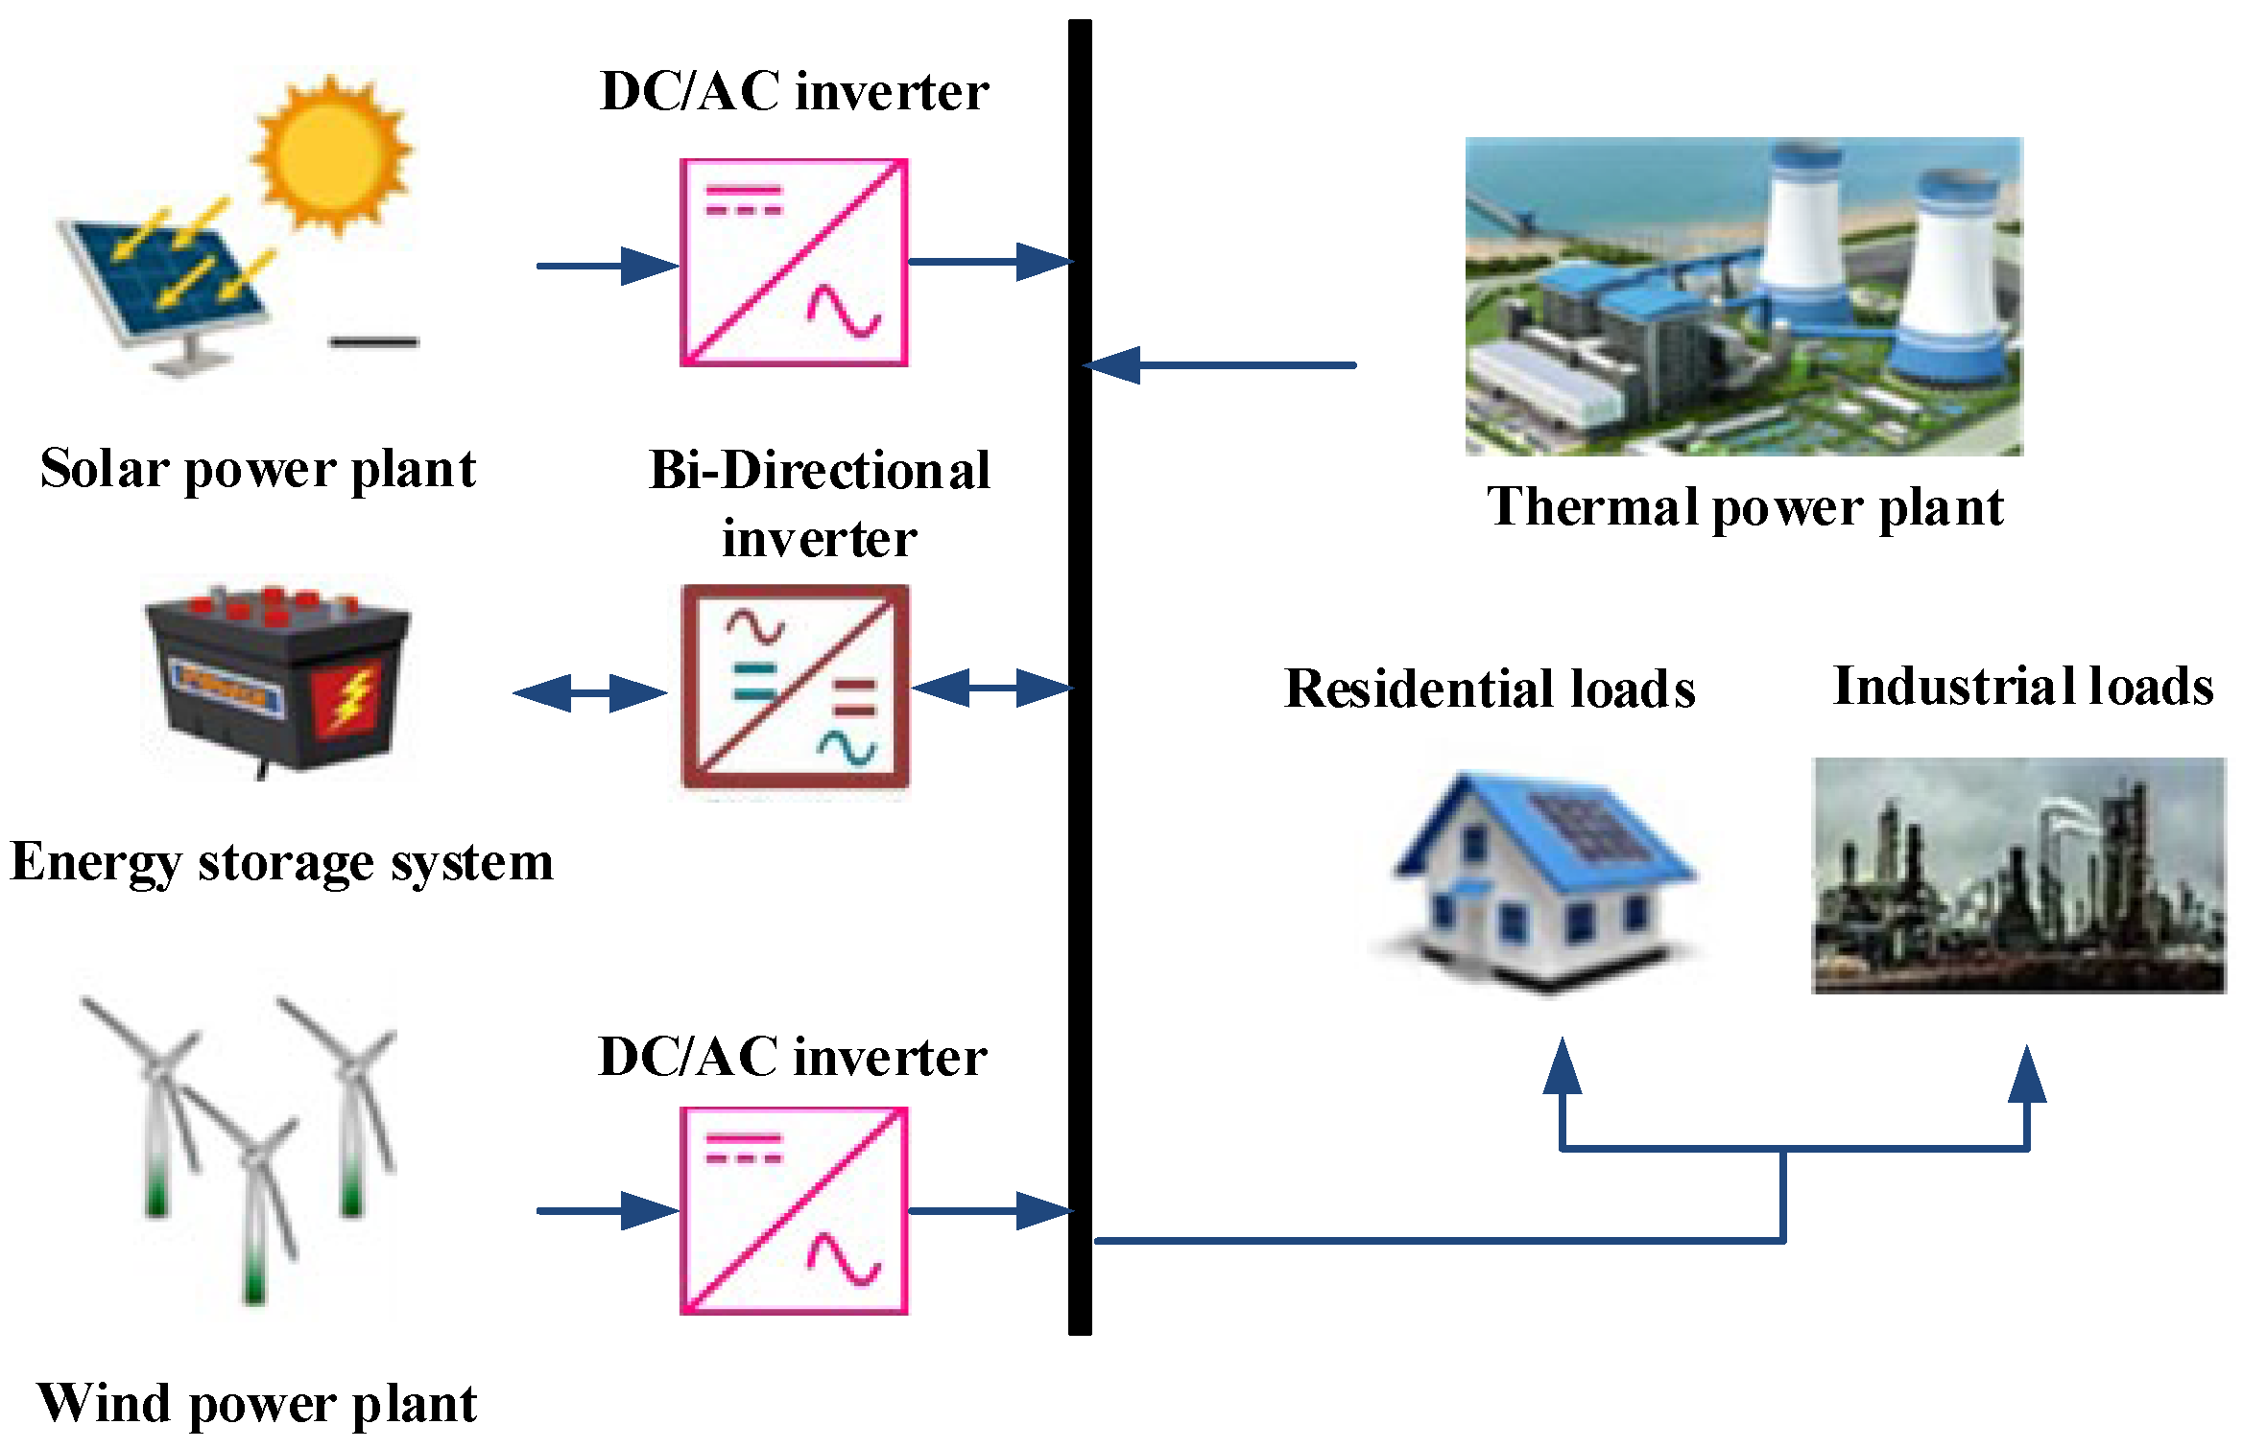
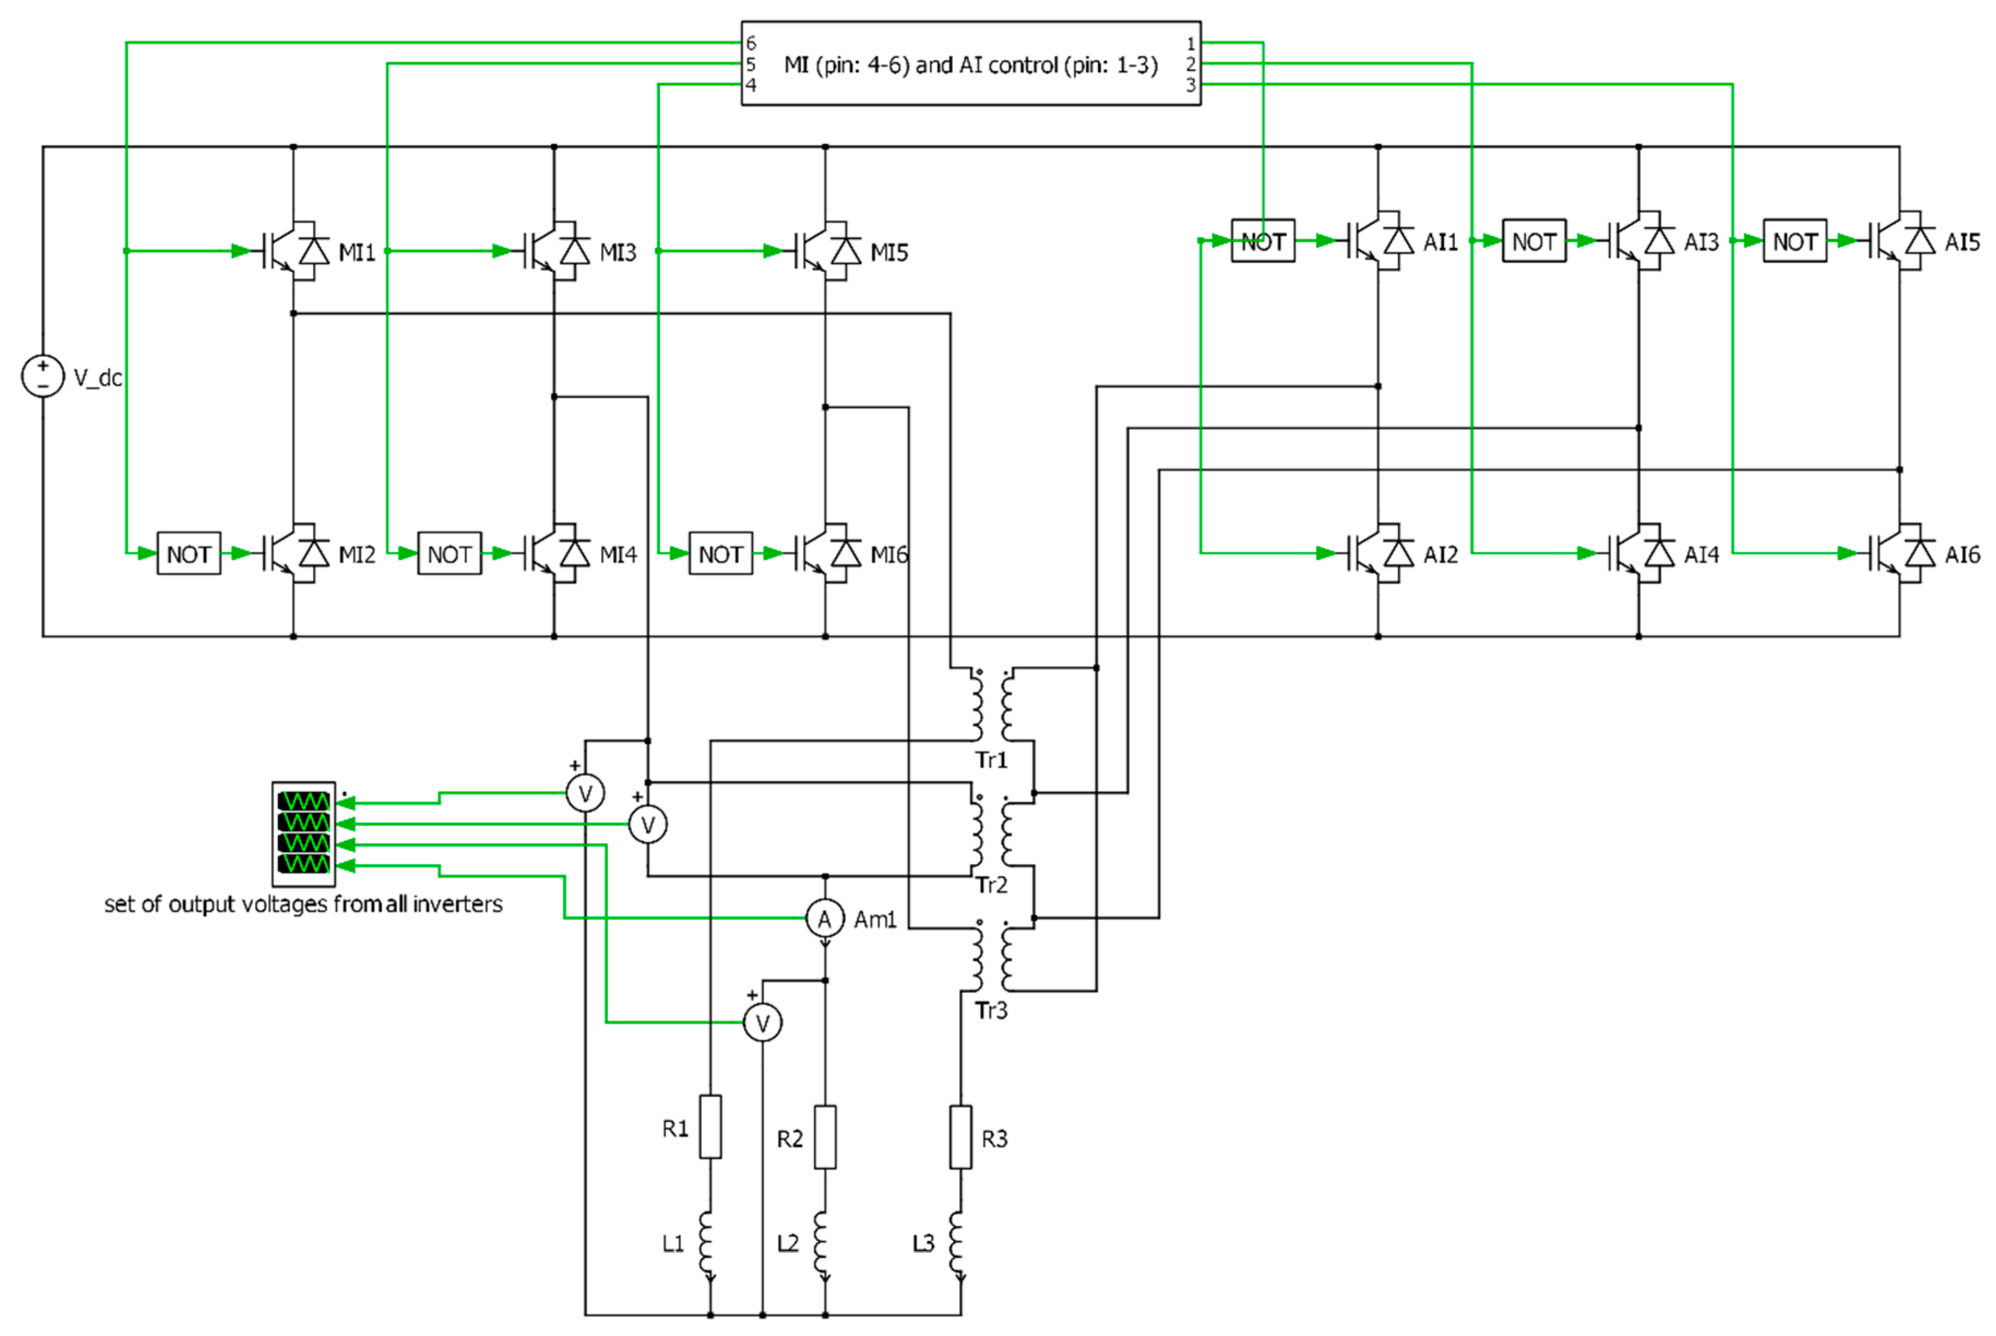
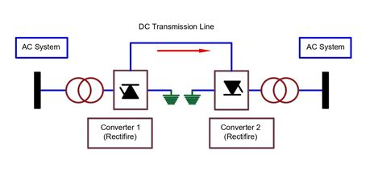
VSC
Voltage Source Converter
Key Features of VSCs
4. Control Flexibility: The output of a VSC can be controlled in terms of both magnitude and phase angle, making it suitable for a wide range of applications, including HVDC transmission, renewable energy integration, and active filtering.
FACTS
Notes:
In the context of power electronics and electrical engineering, VSC stands for Voltage Source Converter. A Voltage Source Converter is a type of power electronic converter that converts DC voltage to AC voltage or vice versa. It is called a "voltage source" because it is typically connected to a DC voltage source and can supply or absorb power from an AC system.

Slide 8
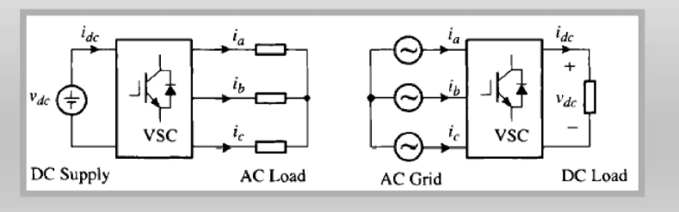
Bidirectional
Power Flow
Whether converter serves as an inverter or a rectifier, the power flow in the converter circuit is bidirectional: the power can flow from its DC side to AC side and vice versa.

Slide 9
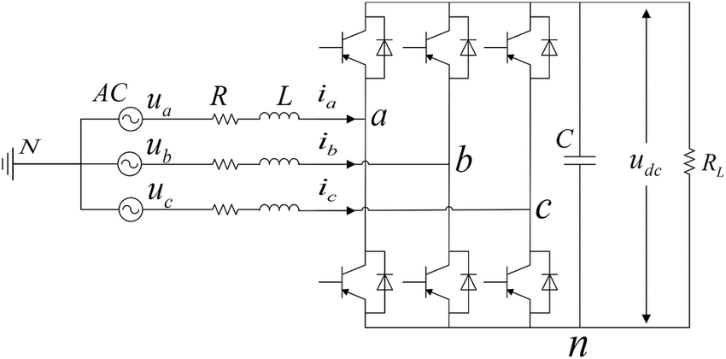
Bidirectional
Power Flow
"Unified Converter Topology“
Same circuit operates as inverter OR rectifier
Freewheeling diodes enable passive rectification
Active switches enable controlled rectification

Slide 10
Bidirectional
Power Flow
  Regenerative braking in EVs
  Grid-tie renewable energy systems
  Four-quadrant motor drives
  Power Supplies and Uninterruptible Power Supplies (UPS)

Slide 11
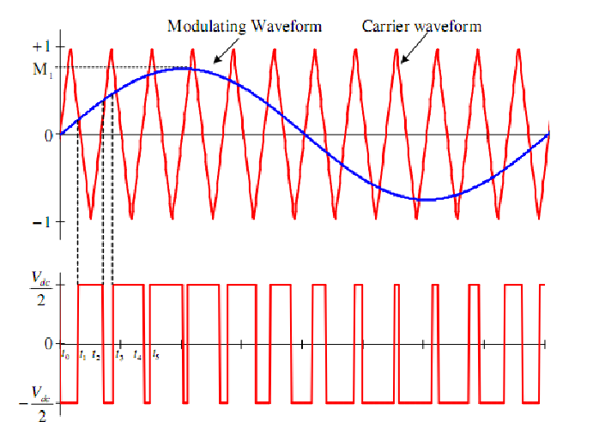
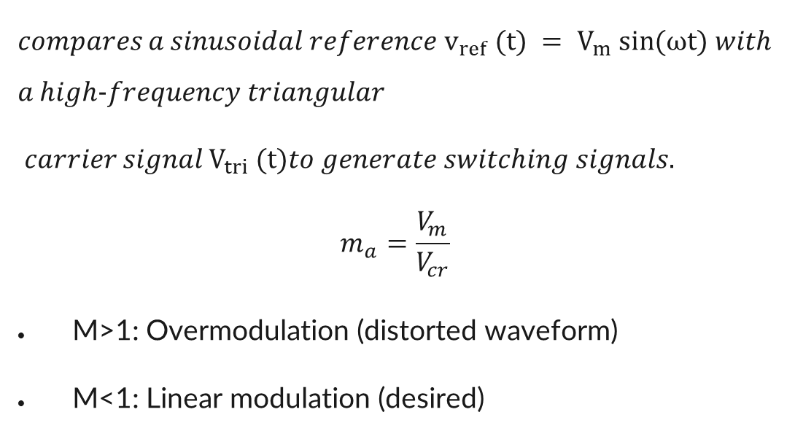
PWM
𝑐𝑜𝑚𝑝𝑎𝑟𝑒𝑠 𝑎 𝑠𝑖𝑛𝑢𝑠𝑜𝑖𝑑𝑎𝑙 𝑟𝑒𝑓𝑒𝑟𝑒𝑛𝑐𝑒 $v_{ref} (t) = V_{m} sin⁡(ωt)$𝑤𝑖𝑡ℎ 𝑎 ℎ𝑖𝑔ℎ-𝑓𝑟𝑒𝑞𝑢𝑒𝑛𝑐𝑦 𝑡𝑟𝑖𝑎𝑛𝑔𝑢𝑙𝑎𝑟
𝑐𝑎𝑟𝑟𝑖𝑒𝑟 𝑠𝑖𝑔𝑛𝑎𝑙 $V_{tri} (t)$𝑡𝑜 𝑔𝑒𝑛𝑒𝑟𝑎𝑡𝑒 𝑠𝑤𝑖𝑡𝑐ℎ𝑖𝑛𝑔 𝑠𝑖𝑔𝑛𝑎𝑙𝑠.
$$m_{a}=\frac{V_{m}}{V_{cr}}$$
M>1: Overmodulation (distorted waveform)
M<1: Linear modulation (desired)

Slide 12
Types of PWM
SPWM (Sinusoidal reference)
SVPWM (Space vector reference)
Others (Square, trapezoidal, etc.)

Slide 13
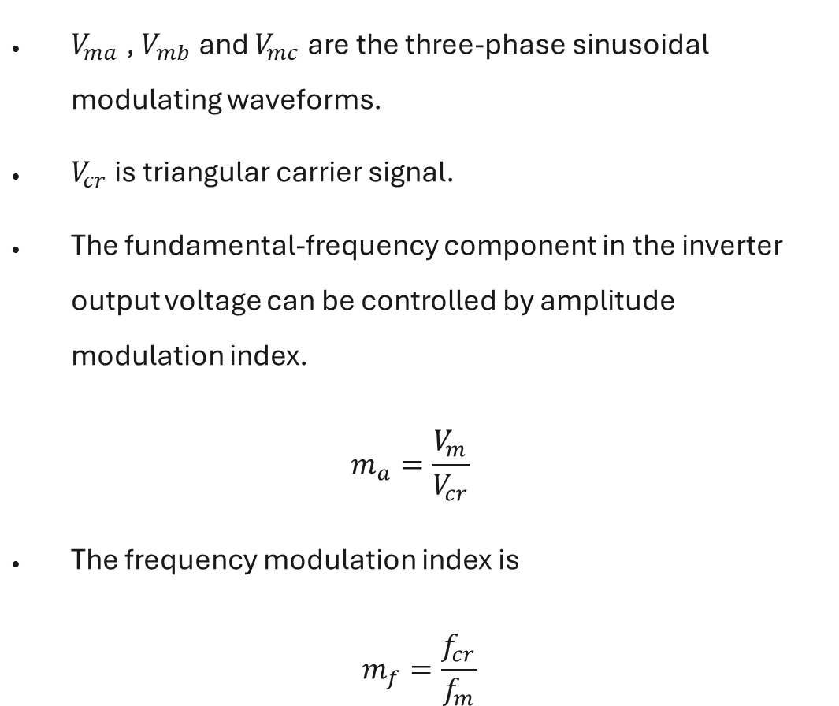
Sinusoidal PWM
SPWM
$V_{ma}$ , $V_{mb}$ and $V_{mc}$ are the three-phase sinusoidal modulating waveforms.
$V_{cr}$ is triangular carrier signal.
The fundamental-frequency component in the inverter output voltage can be controlled by amplitude modulation index.
$$m_{a}=\frac{V_{m}}{V_{cr}}$$
The frequency modulation index is
$$m_{f}=\frac{f_{cr}}{f_{m}}$$

Slide 14
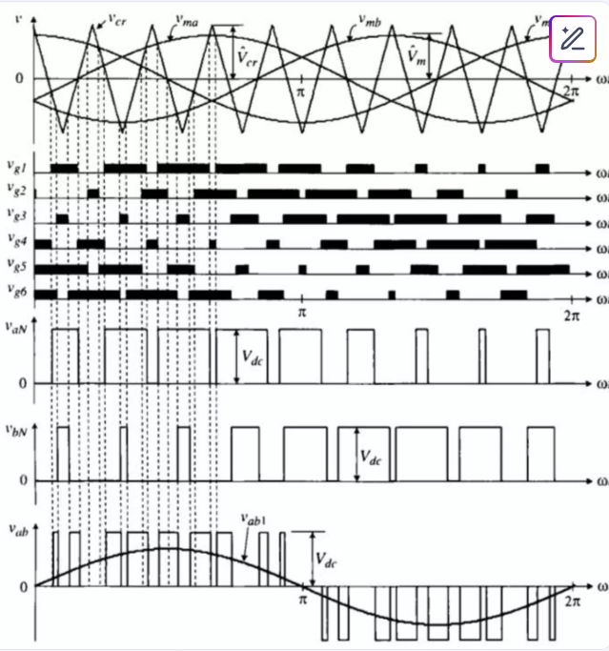
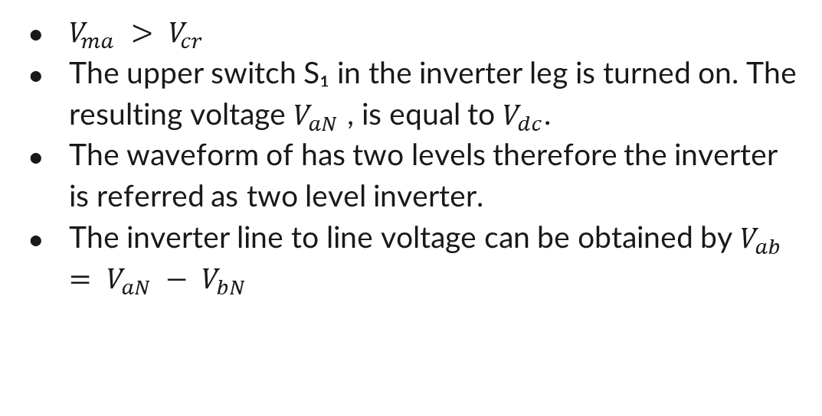
SPWM
$V_{ma} > V_{cr}$
The upper switch S₁ in the inverter leg is turned on. The resulting voltage $V_{aN}$ , is equal to $V_{dc}$.
The waveform of has two levels therefore the inverter is referred as two level inverter.
The inverter line to line voltage can be obtained by $V_{ab} = V_{aN} − V_{bN}$

Slide 15
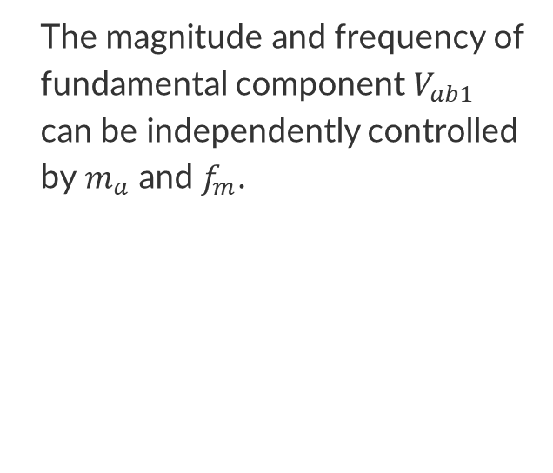
SPWM
The magnitude and frequency of fundamental component $V_{ab1}$ can be independently controlled by$m_{a}$ and $f_{m}$.

Slide 16
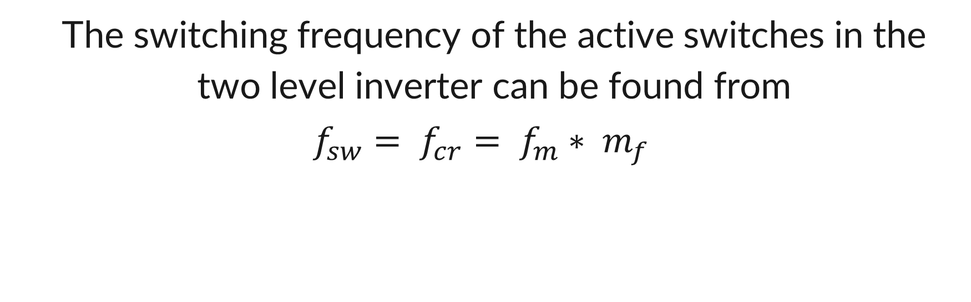
SPWM
The switching frequency of the active switches in the two level inverter can be found from
$$f_{sw}= f_{cr}= f_{m}∗ m_{f}$$

Slide 17

SPWM
The line-to-line voltage contains the desired sinusoidal fundamental component plus high-frequency harmonics that we filter out.

Slide 18
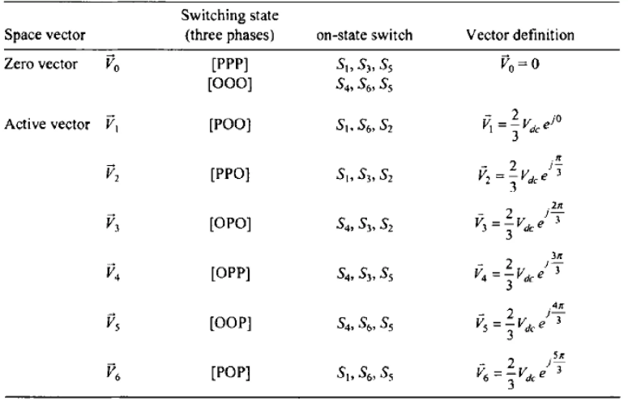
Space Vector Theory
Space Vector Modulation takes a different approach.
Instead of treating each phase independently, SVM considers the three-phase system as a single rotating vector.

Slide 19
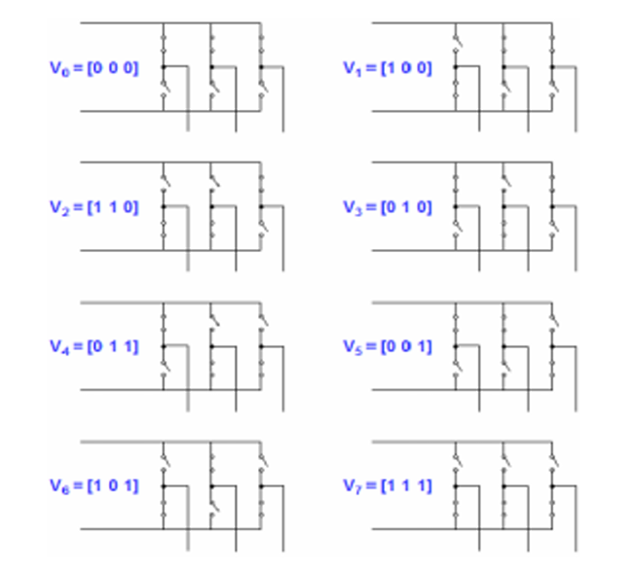
Space Vector Theory
Space Vector Modulation takes a different approach.
Instead of treating each phase independently, SVM considers the three-phase system as a single rotating vector.

Slide 20
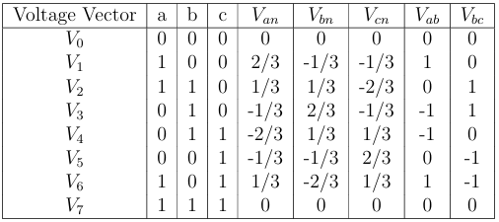
Space Vector Theory

Slide 21
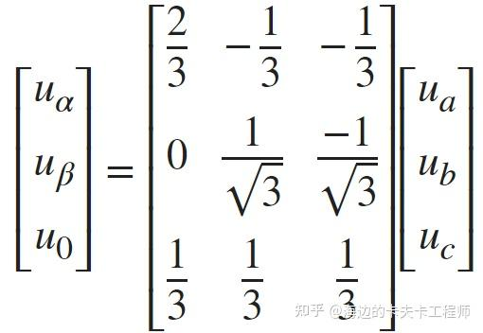
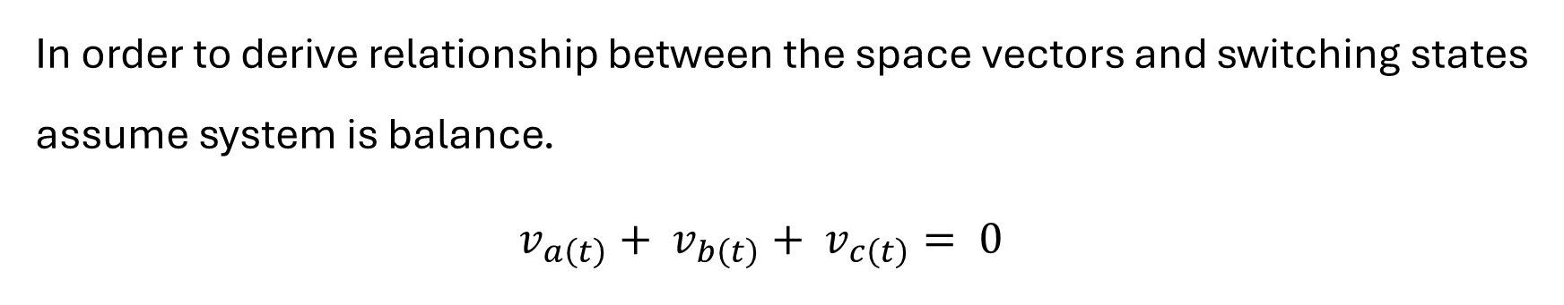
Space Vector Theory
In order to derive relationship between the space vectors and switching states assume system is balance.
$$v_{a\left(t\right)}+ v_{b\left(t\right)}+ v_{c\left(t\right)}= 0$$
Notes:
Key Relationships:
Magnitude for active vectors:
1|V̄1| = |V̄2| = ... = |V̄6| = (2/3)Vdc
Angles for active vectors:
1V̄1: 0°, V̄2: 60°, V̄3: 120°, V̄4: 180°, V̄5: 240°, V̄6: 300°
Zero vectors:
1V̄0 = V̄7 = 0 (all phases at same potential)

Slide 22
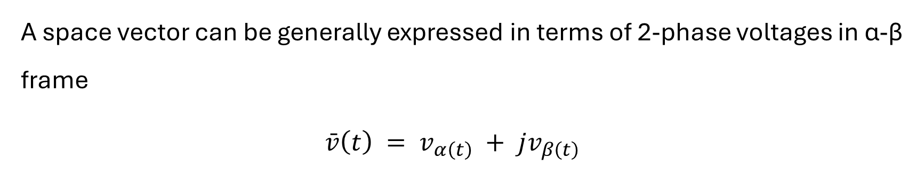
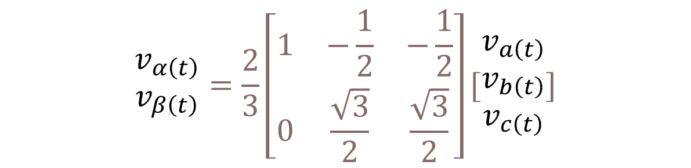
Space Vector Theory
A space vector can be generally expressed in terms of 2-phase voltages in α-β frame
$$\bar{v}\left(t\right) = v_{α\left(t\right)} + jv_{β\left(t\right)}$$
$$\begin{matrix}v_{α\left(t\right)} \\ v_{β\left(t\right)}\end{matrix}=\frac{2}{3}\left[\begin{matrix}1 & −\frac{1}{2} & −\frac{1}{2} \\ 0 & \frac{\sqrt{3}}{2} & \frac{\sqrt{3}}{2}\end{matrix}\right][\begin{matrix}v_{a\left(t\right)} \\ v_{b\left(t\right)} \\ v_{c\left(t\right)}\end{matrix}]$$
Notes:
Key Relationships:
Magnitude for active vectors:
1|V̄1| = |V̄2| = ... = |V̄6| = (2/3)Vdc
Angles for active vectors:
1V̄1: 0°, V̄2: 60°, V̄3: 120°, V̄4: 180°, V̄5: 240°, V̄6: 300°
Zero vectors:
1V̄0 = V̄7 = 0 (all phases at same potential)

Slide 23
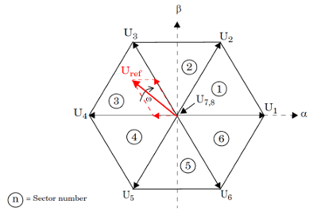
SVM Implementation

Slide 24
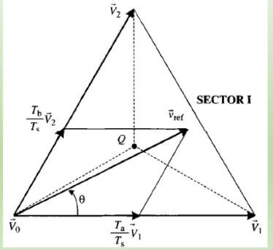
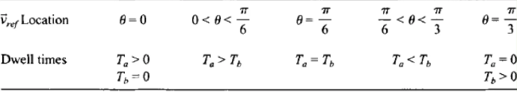
SVM Implementation

Slide 25
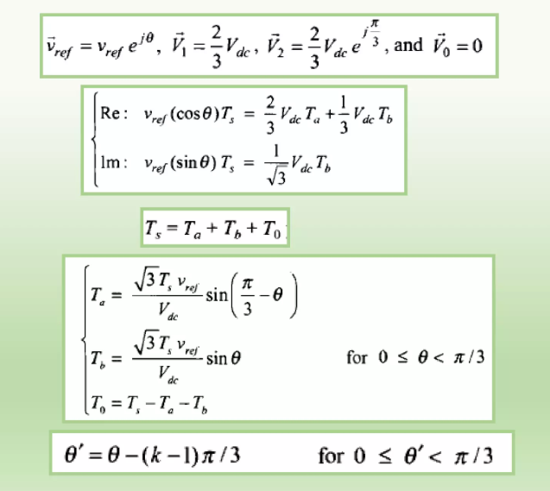
SVM Implementation

Slide 26
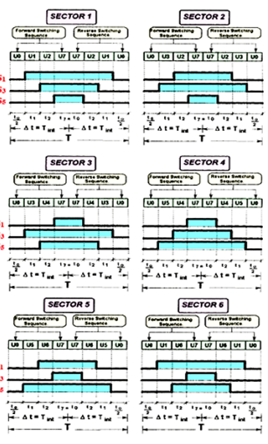
SVM Implementation

Slide 27
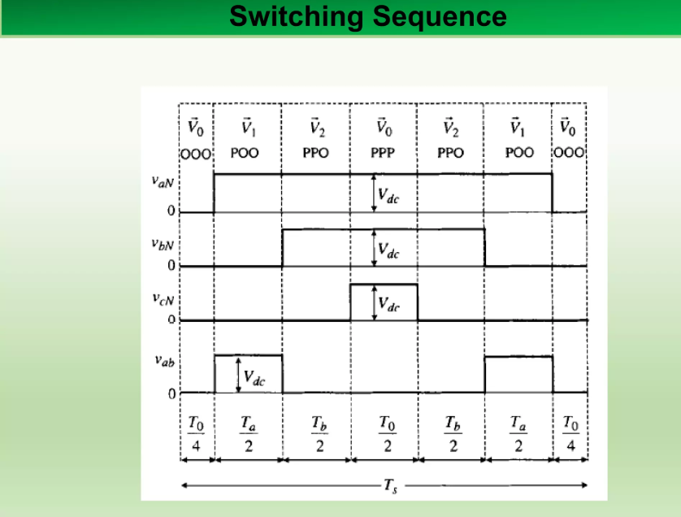
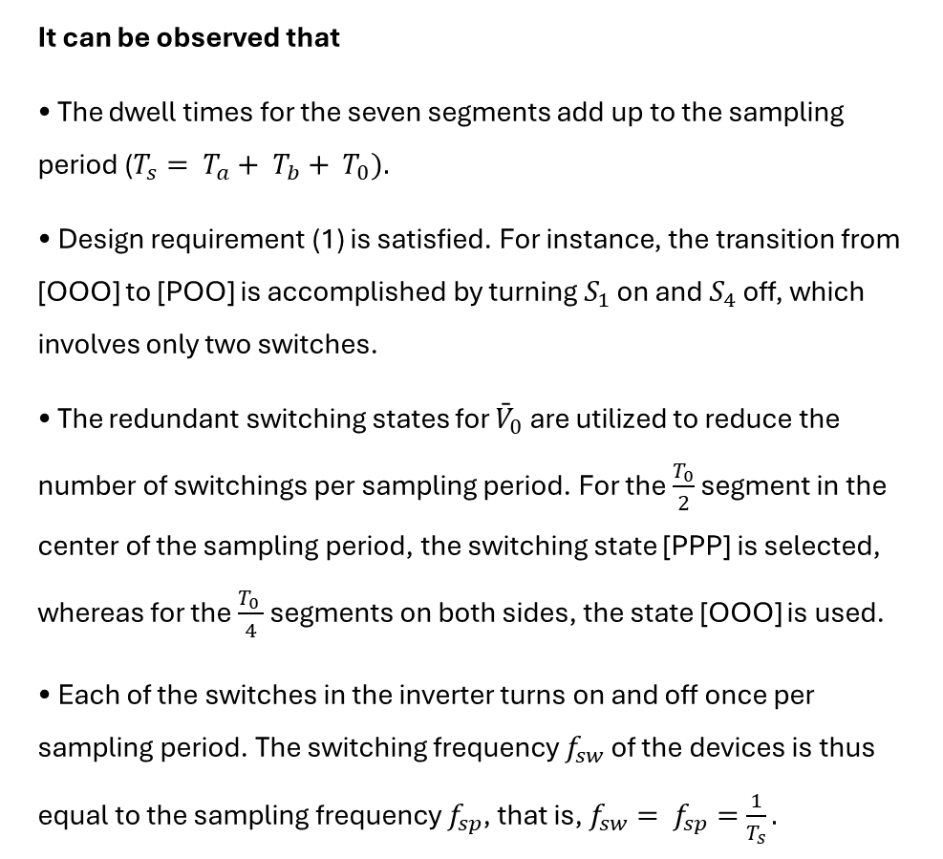
SVM Implementation
It can be observed that
• The dwell times for the seven segments add up to the sampling period ($T_{s}= T_{a}+ T_{b}+ T_{0}).$
• Design requirement (1) is satisfied. For instance, the transition from [OOO] to [POO] is accomplished by turning $S_{1}$ on and $S_{4}$ off, which involves only two switches.
• The redundant switching states for ${\bar{V}}_{0}$ are utilized to reduce the number of switchings per sampling period. For the $\frac{T_{0}}{2}$ segment in the center of the sampling period, the switching state [PPP] is selected, whereas for the $\frac{T_{0 }}{4}$ segments on both sides, the state [OOO] is used.
• Each of the switches in the inverter turns on and off once per sampling period. The switching frequency $f_{sw}$of the devices is thus equal to the sampling frequency $f_{sp}$, that is, $f_{sw}= f_{sp}=\frac{1}{T_{s}}.$

Slide 28
SVM Implementation
SVPWM is a continuous modulation technique that:
Uses all three phases actively switching throughout the entire fundamental period
Synthesizes the reference voltage vector by combining adjacent active vectors and zero vectors
Provides excellent DC bus utilization (up to 15.5% better than sinusoidal PWM)
Results in lower harmonic distortion
Notes:
1. SPWM Limitation:
1Maximum output (line-to-neutral) = Vdc/2 2Maximum output (line-to-line) = (√3)(Vdc/2) = 0.866 Vdc
2. SVPWM Capability:
1Maximum output (line-to-neutral) = Vdc/√3 2Maximum output (line-to-line) = (√3)(Vdc/√3) = Vdc
SVPWM can produce output voltages up to Vdc/√3 while SPWM is limited to Vdc/2, giving SVPWM a 15.47% advantage.

Slide 29
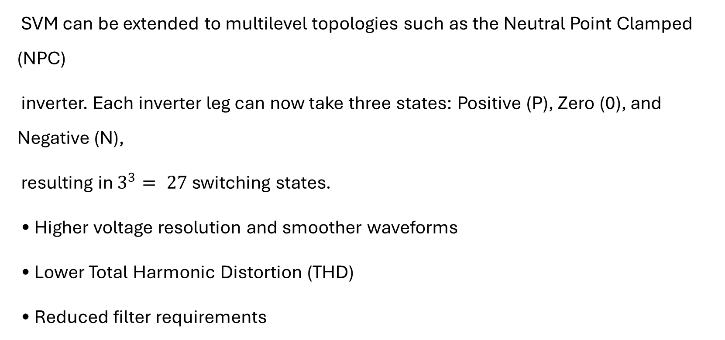
SVM Implementation
SVM can be extended to multilevel topologies such as the Neutral Point Clamped (NPC)
inverter. Each inverter leg can now take three states: Positive (P), Zero (0), and Negative (N),
resulting in $3^{3}= 27$ switching states.
• Higher voltage resolution and smoother waveforms
• Lower Total Harmonic Distortion (THD)
• Reduced filter requirements
Notes:
1. SPWM Limitation:
1Maximum output (line-to-neutral) = Vdc/2 2Maximum output (line-to-line) = (√3)(Vdc/2) = 0.866 Vdc
2. SVPWM Capability:
1Maximum output (line-to-neutral) = Vdc/√3 2Maximum output (line-to-line) = (√3)(Vdc/√3) = Vdc
SVPWM can produce output voltages up to Vdc/√3 while SPWM is limited to Vdc/2, giving SVPWM a 15.47% advantage.

Slide 30
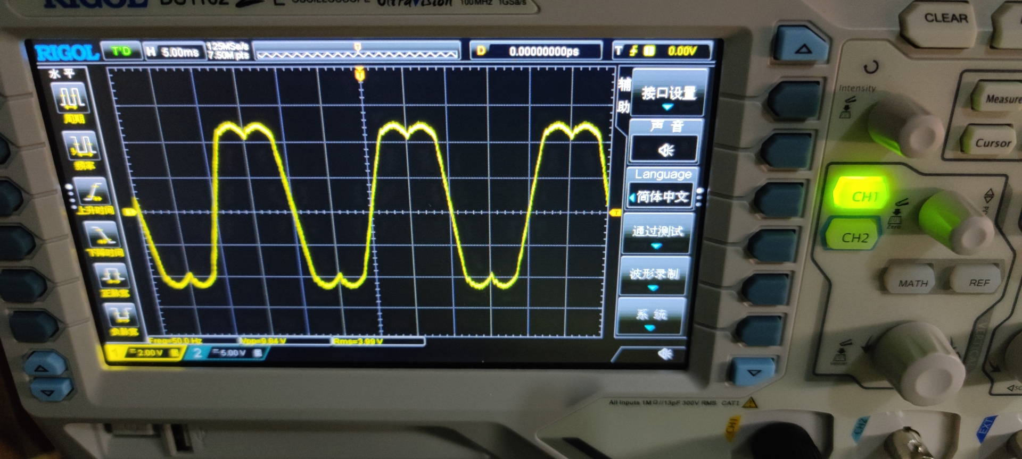
SVM Implementation
Notes:
SVPWM provides 15% better DC bus utilization because it uses the full hexagonal voltage boundary instead of being limited to a circular boundary like SPWM. This is achieved by coordinating all three phases together and injecting an optimal common-mode voltage that doesn't affect the motor but allows us to reach closer to the DC rails.

Slide 31
DPWM is essentially a modification of SVPWM

Slide 32
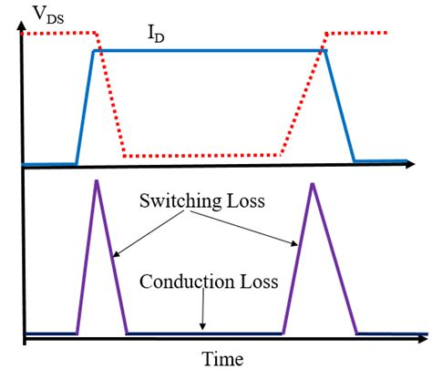
DPWM that trades some waveform quality for significant switching loss reduction, making it valuable in high-power applications where efficiency is paramount.

Slide 33
Feature | SVPWM | DPWM
Switching Pattern | Continuous | One phase clamped
Switching Losses | Higher | 33% reduction
THD | Lower | Slightly higher
DC Bus Utilization | Excellent | Excellent

Slide 34
DPWM
One phase is clamped (not switching) to either the positive or negative DC rail for portions of the fundamental period
The clamping typically occurs for 60° or 120° intervals
Notes:
Only two phases are actively switching during the clamped periods

Slide 35
DPWM
DPWM uses the same space vector concept as SVPWM but modifies the zero vector distribution
  SVPWM typically uses both zero vectors (V₀ and V₇)
  DPWM uses only one zero vector during clamping periods

Slide 36
DPWM
• Starting with SVPWM calculations
• Adding a common-mode signal to clamp one phase
• Redistributing the switching patterns

Slide 37
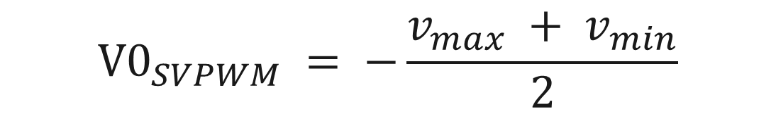
Common-Mode Voltage
$$V0_{SVPWM} = −\frac{v_{max} + v_{min}}{2}$$
Continuous, smooth variation
Typically 3rd harmonic shape (triple fundamental frequency)
Zero average value
Amplitude ≈ Vdc/6

Slide 38
DPWM
Common DPWM Variants
DPWM1: Clamps during peak current periods (minimum switching losses)
DPWM2: Clamps at 30° phase shift from DPWM1
DPWM3: Clamps during peak voltage periods
DPWMMIN/MAX: Clamps to minimize specific losses

Slide 39
Selection Criteria
The optimal PWM technique depends on:
• Power Level: DPWM preferred for high-power (>50kW), SVPWM for medium power.
• Switching Frequency: SVPWM better for high-frequency (>10kHz) operation.
• Efficiency Requirements: DPWM for maximum efficiency, SVPWM for balanced performance.
• Acoustic Noise: SVPWM or variable frequency PWM for low-noise applications.
• Processor Capability: SPWM for low-end controllers, SVPWM/DPWM for advanced processors

Slide 40
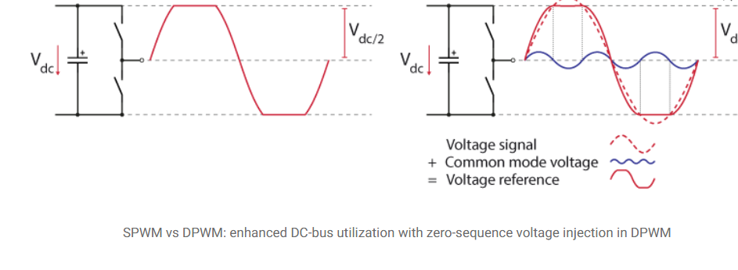
DPWM

Slide 41
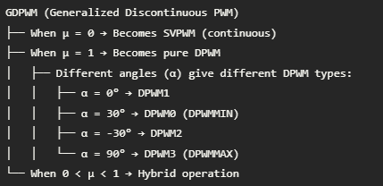
Notes:
Operating Mode Selection: 2- High Speed/High Load: μ = 1, α = 0° (DPWM1) 3 → Maximum efficiency 4- Medium Speed: μ = 0.5-0.8 5 → Balanced performance 6- Low Speed/Light Load: μ = 0 (SVPWM) 7 → Best waveform qualit
v0 = μ · f(θ, α) + (1-μ) · v0_SVPWM 2 3Where: 4- μ: discontinuity factor (0 to 1) 5- α: clamping angle parameter 6- θ: reference vector angle 7- f(θ, α): clamping function

Slide 42
DPWM
Reduction in the number of commutations and, consequently, switching losses. For a defined value of allowable switching losses, the effective switching frequency can be increased by 3/2, resulting in a reduction of the RMS value of the mains current harmonics for high modulation index values. Consequently, a reduced filtering effort is required, as DPWM enables the use of smaller inductors and capacitors, contributing to an overall reduction in the size of passive components. This enhances power density and system integration in space-constrained applications.
Equal loading of all the switches, as each switch conducts for 60°, reducing the requirement of thermal management of the semiconductors.
Enhanced DC-bus utilization in motor drive applications leads to a higher output voltage, broadening the motor’s speed range [2]. Moreover, achieving a higher DC-bus utilization is crucial for cost and power density improvements [3]. In grid-tie operations, a higher output voltage is advantageous for optimizing power output from renewable sources, ensuring seamless synchronization with the electrical grid, improving overall power quality, facilitating the integration of multiple energy sources, and efficiently feeding excess power back into the grid [4].

Slide 43
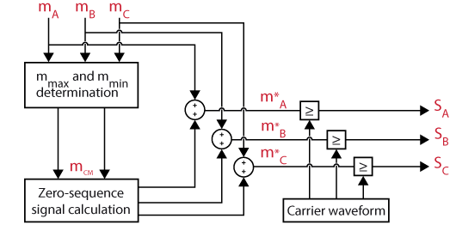
Zero-sequence signal generation for Discontinuous PWM

Slide 44
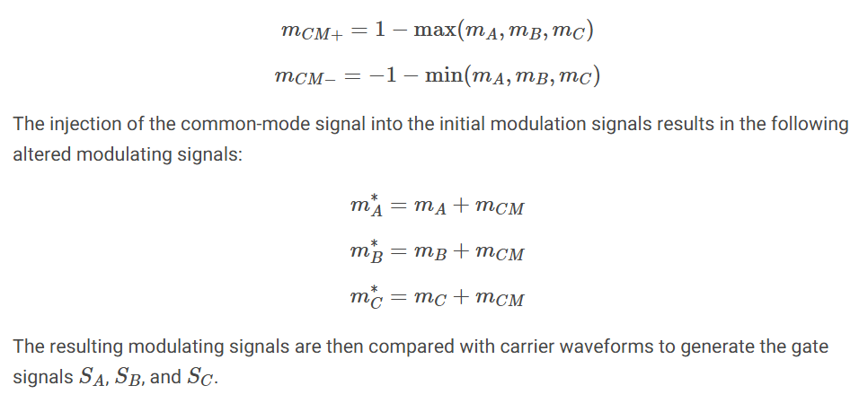
Zero-sequence signal generation for Discontinuous PWM

Slide 45
Classification of the Discontinuous PWM methods
Continual-clamp PWM (CCPWM) continually clamps each phase to one of the two DC-buses for 60° or 120° duration in each half of the fundamental cycle.
  One saturation of 120°: this corresponds to the methods “120° DPWM with -DC clamping ” or “120° DPWM with +DC clamping“.
  Two saturations of 60°: this corresponds to the methods “60° DPWM clamping“, “60° DPWM with +30° phase shift clamping”, and “60° DPWM with -30° phase shift clamping”. In general, the 60° clamping duration can be positioned anywhere during the voltage cycle. For an arbitrary γ (i.e., 0° ≤ γ ≤ 60°) this results in the expression [5]:
Split-clamp PWM (SCPWM) divides the 60° clamping interval into two sub-intervals, which are not necessarily equal, and fall in two different quarter cycles.
  Four saturation of 30°: this corresponds to the strategy called “30° SCPWM“.

Slide 46
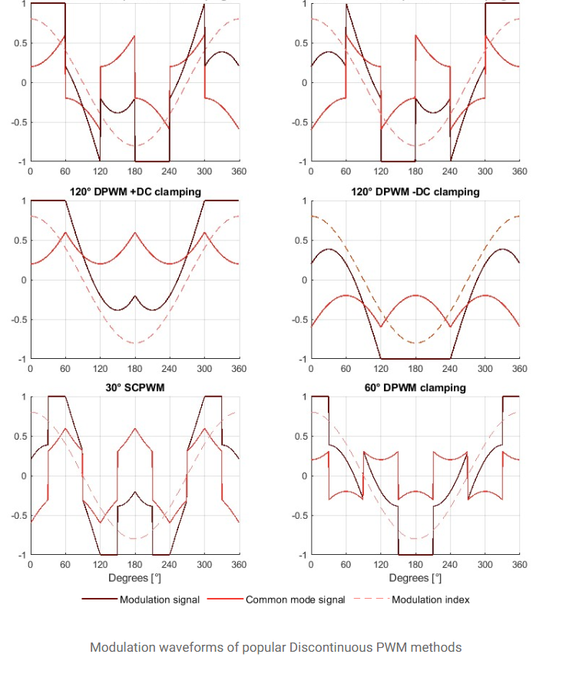

Slide 47
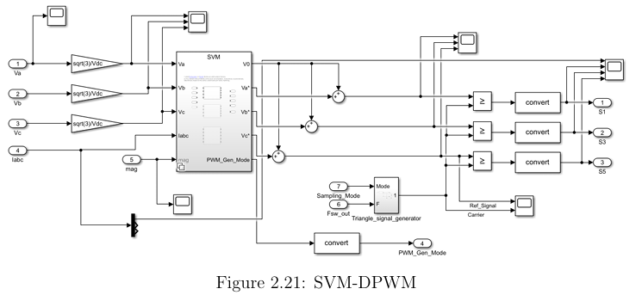

Slide 48
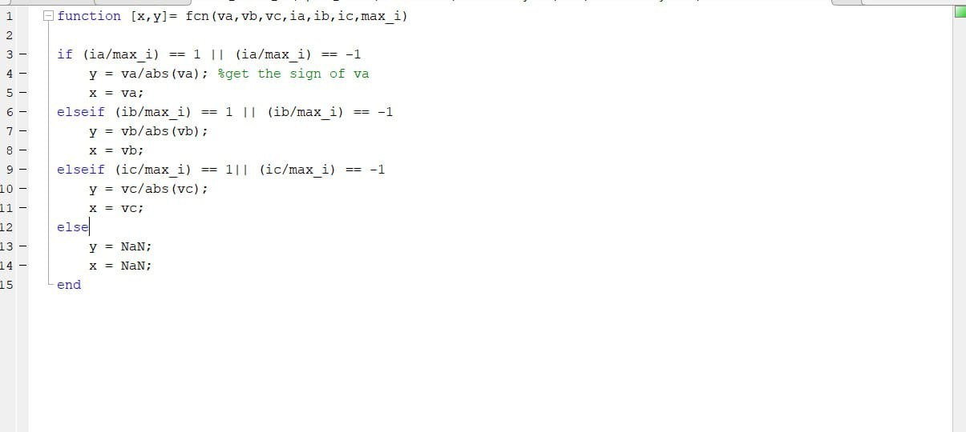
Notes:
this appears to be part of a GDPWM implementation, specifically the function that determines which phase should be clamped. Let me explain what this code does:
Code Analysis:
What this function does:
Identifies which phase is at the limit (saturated at ±1)
Returns:
x: The voltage value of the saturated phase
y: The sign of that phase (+1 or -1)
Breaking it down:
MATLAB
1if (ia/max_i) == 1 || (ia/max_i) == -1 2 % Phase A is at maximum current 3 y = va/abs(va); % Get sign of va (+1 or -1) 4 x = va; % Store va value
This checks if phase A current is at its maximum (positive or negative).
This is GDPWM because:
It's identifying saturation conditions - key for determining when to clamp
It considers current (ia, ib, ic) - GDPWM often uses current information for optimal clamping
The output (x,y) would be used to calculate the common-mode voltage v0
Typical GDPWM flow using this function:
MATLAB
1% 1. Get saturation info 2[x, y] = fcn(va, vb, vc, ia, ib, ic, max_i); 3 4% 2. Calculate clamping voltage (simplified) 5if ~isnan(x) 6 % Phase is saturated, calculate v0 for clamping 7 v0_clamp = y - x; % Push phase to rail 8else 9 % No saturation, use SVPWM 10 v0_clamp = -(max([va,vb,vc]) + min([va,vb,vc]))/2; 11end 12 13% 3. Apply GDPWM blending 14v0 = mu * v0_clamp + (1-mu) * v0_svpwm;
Key GDPWM indicators in your code:
Current-based decisions (ia/max_i) - optimizes clamping timing
Saturation detection - determines when clamping is needed
Phase selection logic - chooses which phase to clamp
What's missing for complete GDPWM:
The μ (mu) parameter calculation
The blending equation
The final v0 calculation
For your presentation:
"This function is part of our GDPWM implementation. It identifies which phase has reached current saturation, providing the information needed to calculate the optimal common-mode voltage for clamping. This current-based approach ensures we clamp during peak current periods, minimizing switching losses."

